Slide 1

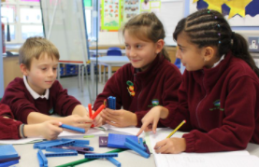
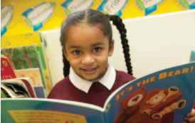
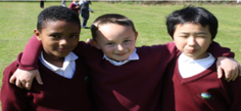
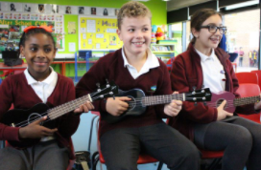
  DVPS – Year 3 & 4 RSHE & Sex Ed
Tuesday 19th May 2026

Slide 2

Aims for this session
Inform you of Relationship, Sex and Health Education Curriculum and what needs to be covered
Tell you about our scheme of work
Outline lessons planned
Look at resources that will be shared with the children

Slide 3
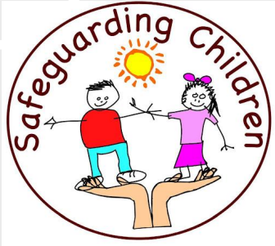
Why is Relationships and Sex (RSE) Education in Schools Important?
High quality RSE helps create safe school communities in which students can grow, learn, and develop positive, healthy behaviour for life, and for the following reasons:
  RSE plays a vital part in schools fulfilling their statutory duties to protect and safeguard their students. Ofsted is clear that schools must have a preventative programme that enables students to learn about safety and risks in relationships.
  Schools maintain a statutory obligation under the Children Act (2004) to promote their students’ wellbeing and under the Education Act (2002) to prepare children and young people for the challenges, opportunities and responsibilities of adult life. A comprehensive RSE programme can have a positive impact on students’ health and wellbeing and their ability to achieve, and can play a crucial part in meeting these obligations.
  Technology is evolving at a tremendous pace. The need to protect children and young people from inappropriate online content, cyberbullying and exploitation is a growing concern. A comprehensive RSE programme can support in addressing these issues.

Slide 4

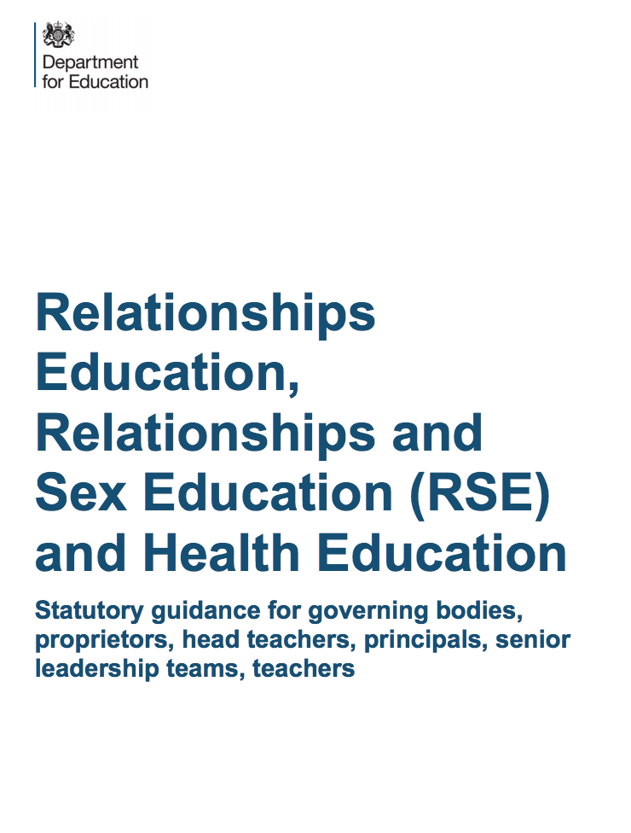
DfE guidance
Relationships and health education (RHE) for primary aged pupils… became compulsory from September 2020
Curriculum UPDATE (taken from DfE Website): https://educationhub.blog.gov.uk/2024/05/new-rshe-guidance-what-it-means-for-sex-education-lessons-in-schools/
Last year, the government brought forward the first review of the curriculum…
The review was informed by the advice of an independent panel of experts. The results of the review and updated guidance for consultation has now been published…
Following the consultation, the guidance will be statutory, which means schools must follow it unless there are exceptional circumstances…
Schools will be able to use the guidance as soon as we publish the final version later this year….

Slide 5
What has to be covered:
    Relationships
      Families and people who care for me
      Caring friendships
      Respectful relationships
      Online relationships
      Being safe
Health Education
  Mental wellbeing
  Internet safety and harms
  Physical health and fitness
  Healthy eating
  Drugs, alcohol and tobacco
  Health and prevention
  Basic first aid
  Changing adolescent body

Slide 6
What has to be covered:
These RHE themes are statutory and parents cannot withdraw their child from these lessons.
‘Sex Education’ which is covered is part of the statutory science curriculum

Slide 7
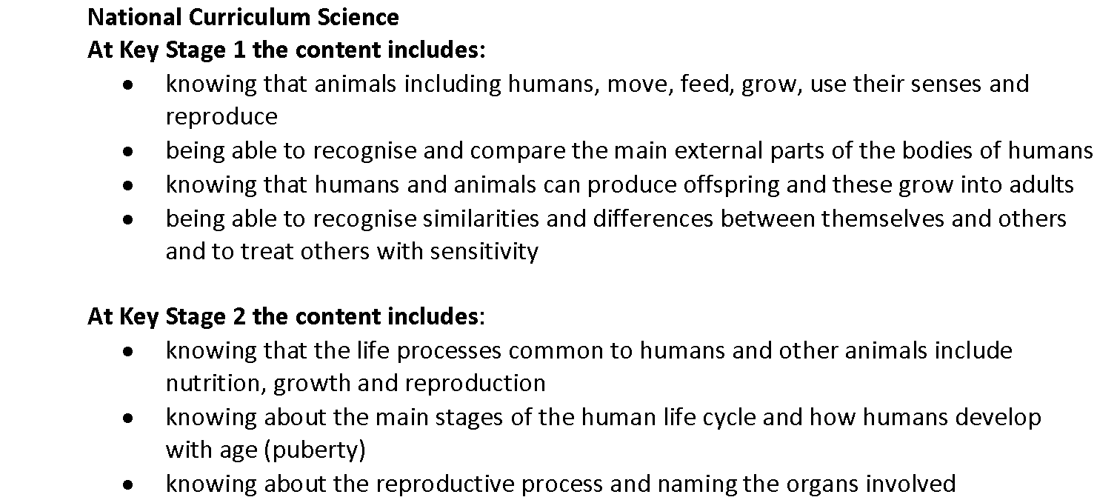
Reproduction & the NC:

Slide 8
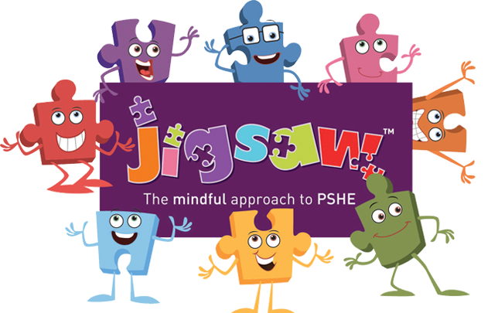
What have we done…
Follow published scheme – Jigsaw
Clear Policy - RHE Policy
  Clearly identified expectations
  Addressed areas of concern
  Clearly laid out where parents may withdraw their child
Consulted Parents
Worked with DVPS Governors
Arrange a parent workshop to share resources

Slide 9
Right to withdraw:
Sex Education is not statutory in primary schools.
The School has identified some of the Jigsaw lessons as Sex Education and therefore parents have the right to withdraw their children from these lessons only.
Year 3 | How Babies Grow | I understand that in animals and humans lots of changes happen between conception and growing up, and that usually it is the female who has the baby | Sex Education
 | Babies | I understand how babies grow and develop in the mother’s uterus I understand what a baby needs to live and grow | Sex Education
 | Outside Body Changes | I understand that boys’ and girls’ bodies need to change so that when they grow up their bodies can make babies I can identify how boys’ and girls’ bodies change on the outside during this growing up process | Sex Education
 | Inside Body Changes | I can identify how boys’ and girls’ bodies change on the inside during the growing up process and can tell you why these changes are necessary so that their bodies can make babies when they grow up | Sex Education
Year 4 | Unique Me | I understand that some of my personal characteristics have come from my birth parents and that this happens because I am made from the joining of their egg and sperm | Sex Education
 | Having a Baby | I can correctly label the internal and external parts of male and female bodies that are necessary for making a baby | Sex Education

Slide 10
Year 3

Slide 11
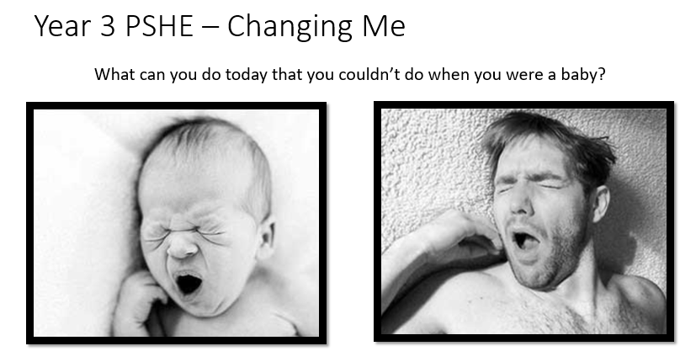
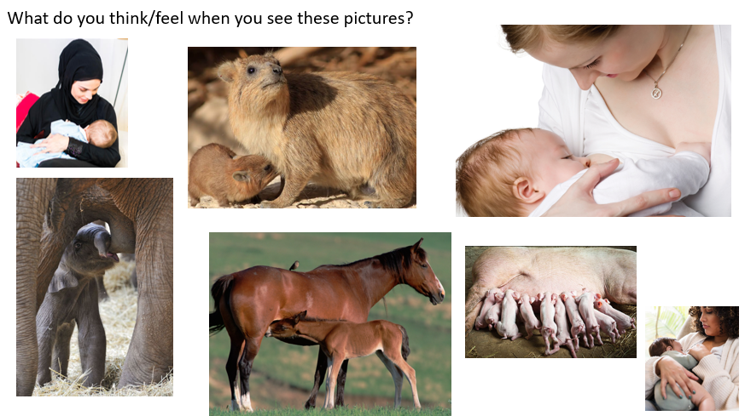
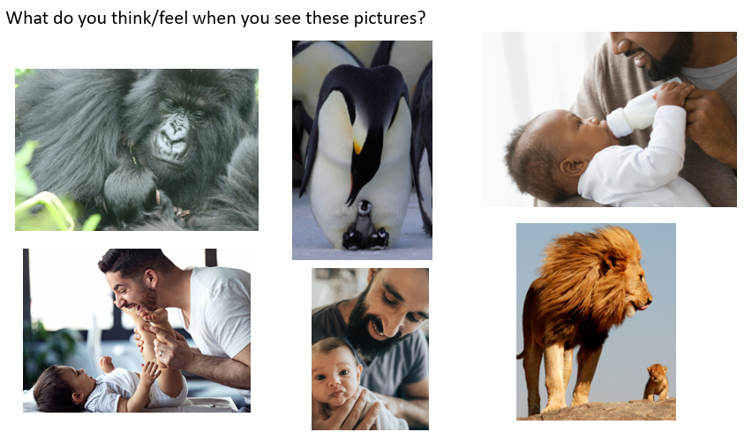
Lesson 1
LQ: Do I understand that changes happen in humans and animals as they grow up?
This is an introductory lesson, which looks into basic changes in growth i.e. we learn to walk, talk, get taller as well as our roles as we grow from baby to adolescent and into adulthood.
The main discussion points are around what babies and children can and can’t do when they’re young, what roles adults play in their growth before we look more closely at reproduction in the next lessons.

Slide 12
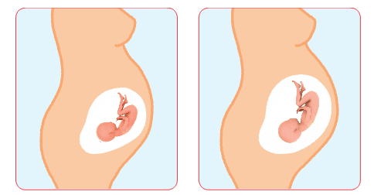

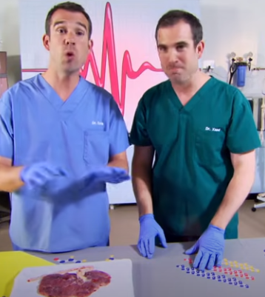
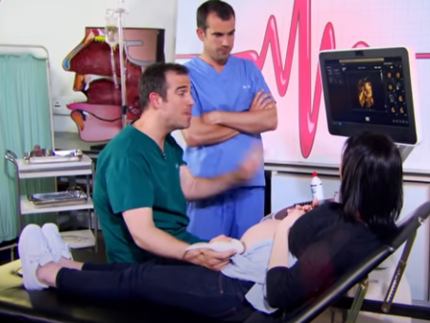
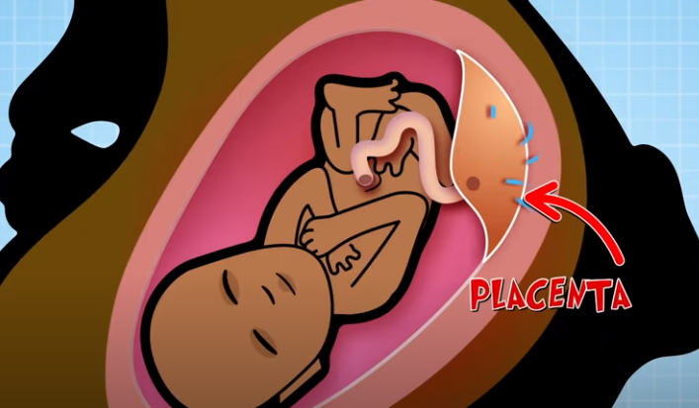
Lesson 2
LQ: Do I understand how a baby grows inside a mother’s womb?
We will be explaining to the children that the baby grows inside the mother’s womb/uterus and gets all its nutrients in order to grow from the mother
https://www.youtube.com/watch?v=n5OcdbBqVSA

Slide 13
Lesson 3
LQ: Do I know how our bodies change as we grow up (outside changes)?
In this lesson we will be:
Introducing and explaining the term puberty.
Explaining that the lesson today will only look at changes on the outside of the body.
Emphasising that puberty is a natural part of growing up for everyone.
Discussing the physical changes that will happen to females and males as they grow using correct terminology
Discussing body changes happen at a different time and pace for each person because everyone is unique.
Offering reassurance that if they are worried about any of the changes, they can talk to a trusted adult about them.

Slide 14
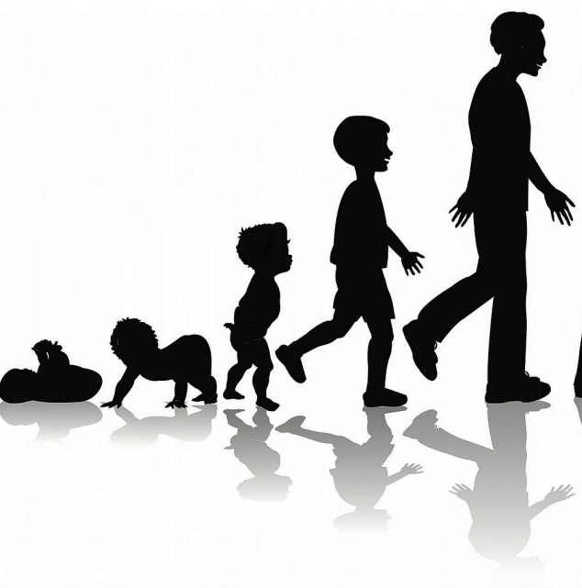
LQ: Do I know how our bodies change as we grow up?
Today we’re going to learn about how our bodies change as we get older! It’s part of the process called puberty.
Can you think of some ways your body will change as you mature and become an adult?

Slide 15









LQ: Do I know how our bodies change as we grow up?
Look at these changes, can you sort them into the correct place on the chart?
Boys Girls Both

Slide 16
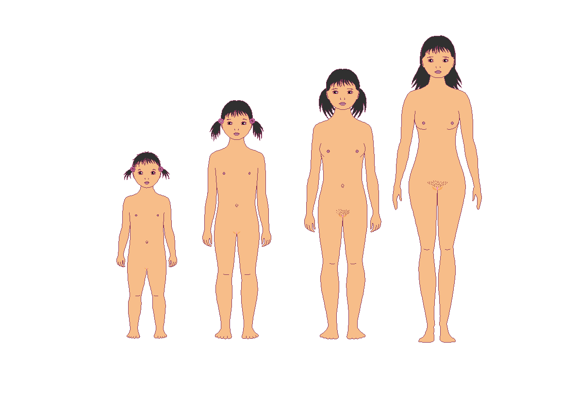
LQ: Do I know how our bodies change as we grow up?

Slide 17
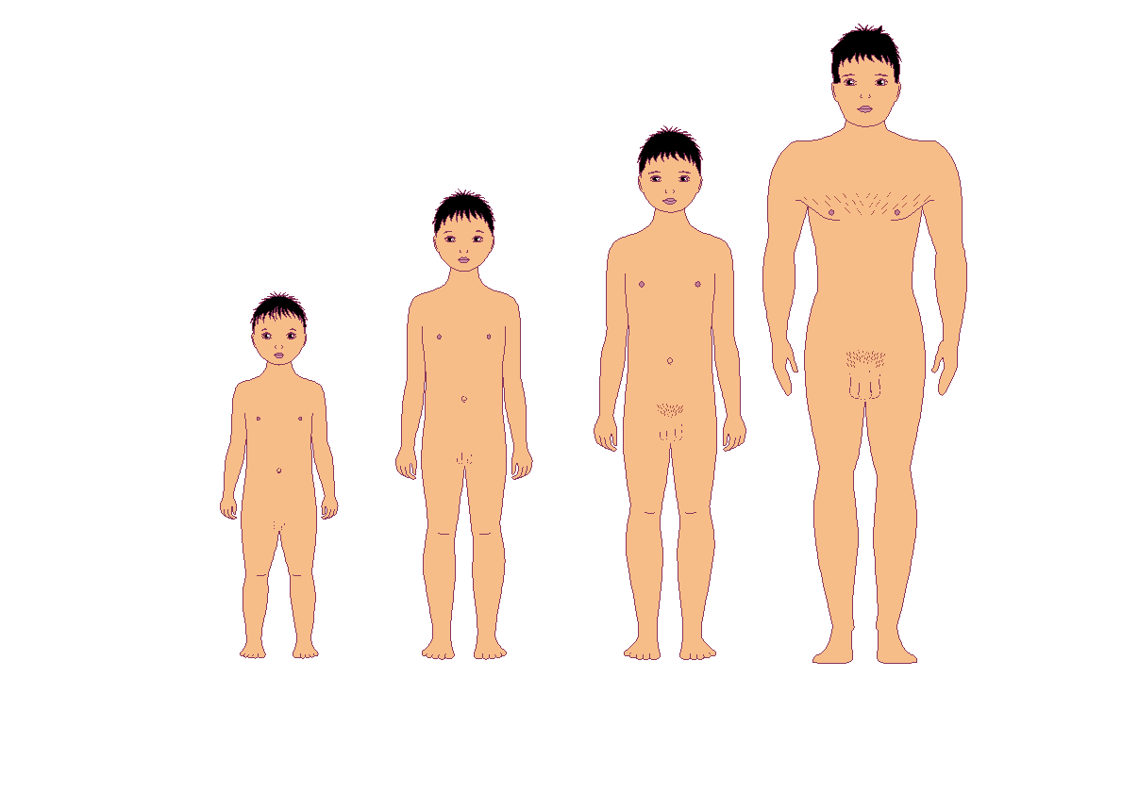
LQ: Do I know how our bodies change as we grow up?

Slide 18
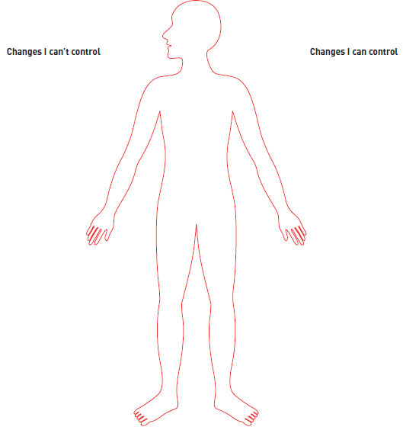
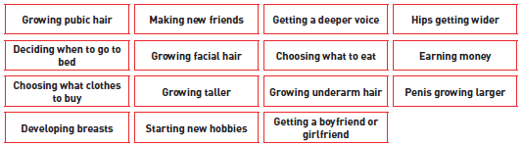
LQ: Do I know how our bodies change as we grow up?
Task: Look at the changes below, which should go in ‘can control’ and which in ‘can’t control’. Write them in the place that you feel is correct. Write down one thing they are looking forward to about growing up, and one thing that they are worried about. How do you feel about any of the changes you can’t control?

Slide 19
Lesson 4
LQ: Do I know how boys and girls bodies change inside as they grow up and name the different organs?
In this lesson we will be:
Introducing and explaining that there are parts of males and females that are needed in reproduction
Looking at both male and female organs
Explaining that men produce sperm and women grow eggs in order for a baby to grow
We will not be explicitly explaining how the egg and sperm join to create a baby, this isn’t the purpose of the lesson
However, if the questions do arise we have agreed as a year group to respond that this is another part of making a baby that will be discussed in a different year. The main thing for us is to remain upbeat, positive, use factual language and terminology so as not to make it feel like a guilty secret.

Slide 20
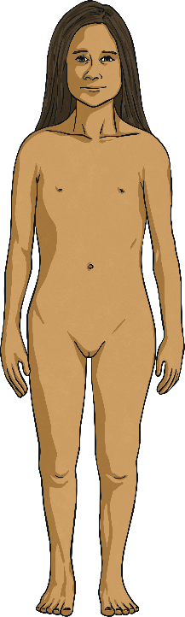
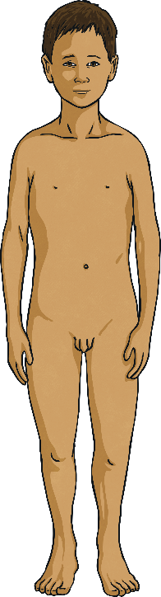
Male and Female Bodies
LQ: Do I know how boys and girls bodies change inside as they grow up and name the different organs?
Talk to your partner about the two bodies below.
What is the same and what is different?
Can you and your partner think why female and male bodies are different?

Slide 21
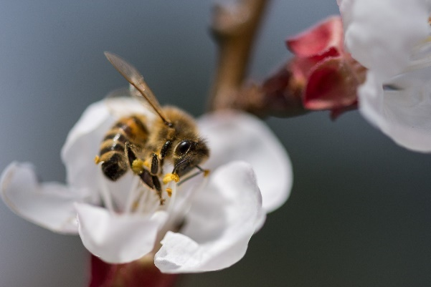
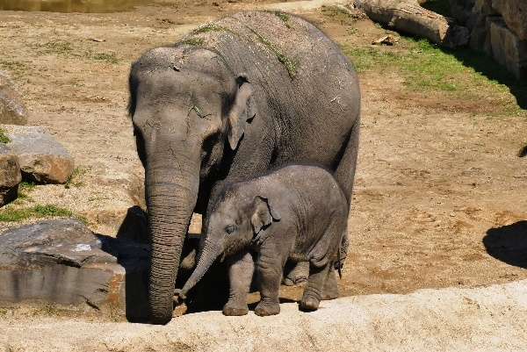
Reproduction
LQ: Do I know how boys and girls bodies change inside as they grow up and name the different organs?
What does reproduction mean?
Let’s explore what you might already know about reproduction.
All living things reproduce – it’s what sets living things apart from non-living matter.
Plants reproduce to make new plants.
Animals reproduce to make baby animals.

Slide 22
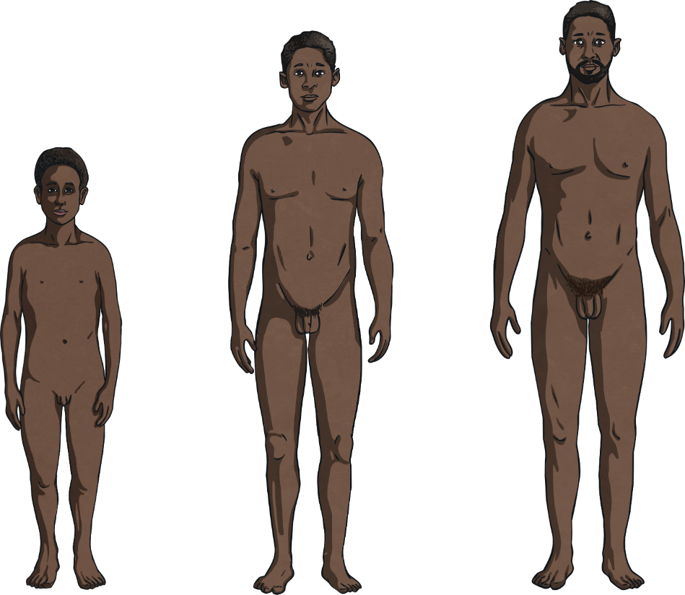
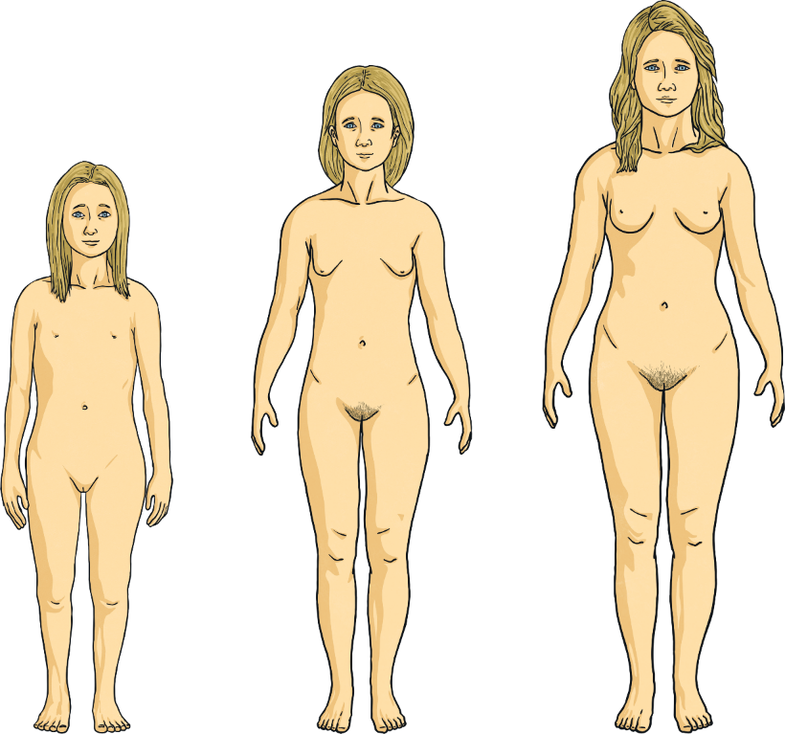
LQ: Do I know how boys and girls bodies change inside as they grow up and name the different organs?
Boys and Girls Growing and Changing
You discussed the differences between female and male bodies at the start of the lesson. You have probably been aware of these differences since you were very young. As children grow into adults, their bodies change.
Adult female and male bodies are still different.

Slide 23

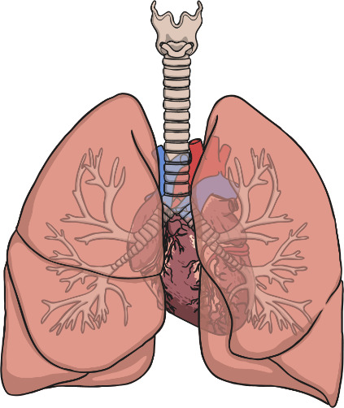
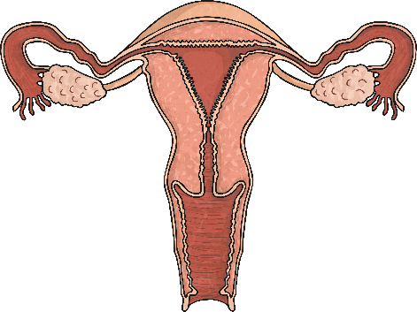
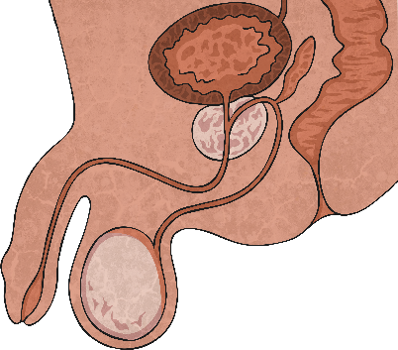
LQ: Do I know how boys and girls bodies change inside as they grow up and name the different organs?
Our Amazing Bodies
There are other similarities and differences between the male and female body that you can’t see because they are inside us.
Some things inside are the same in males and females.
But some things inside are quite different.
penis and testicles
lungs
heart
uterus and ovaries

Slide 24

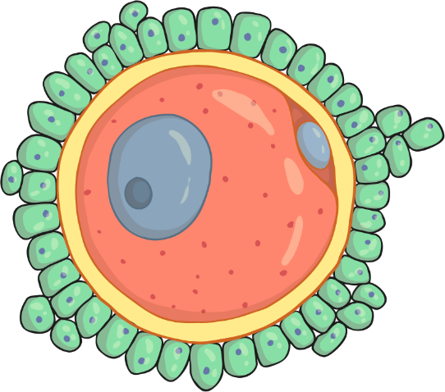
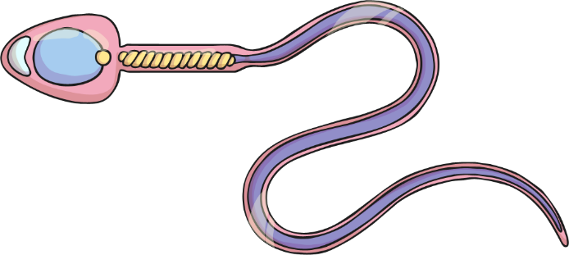
LQ: Do I know how boys and girls bodies change inside as they grow up and name the different organs?
Our Amazing Bodies
Both the male and the female are needed to make a baby. They each produce and store a special ingredient needed for human reproduction.
egg
sperm
The male body makes and stores sperm in the testicles.
The female body makes and stores eggs in the ovaries, which are joined to the uterus by the fallopian tubes.

Slide 25
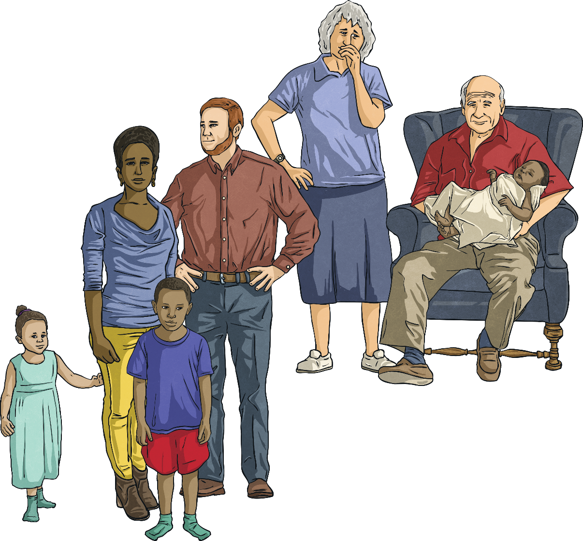

Reproduction
LQ: Do I know how boys and girls bodies change inside as they grow up and name the different organs?
Continuing the Human Species
So, the male and female bodies are different because they have different jobs to do when it comes to human reproduction. If humans didn’t reproduce, the species would die out and there would be
no more humans.

Slide 26
Year 4

Slide 27
In year 4 we have 2 lessons that are classed as Sex Education
Lesson 1
I understand that some of my personal characteristics have come from my birth parents and that this happens because I am made from the joining of their egg and sperm
Lesson 2
I can correctly label the internal and external parts of male and female bodies that are necessary for making a baby
On the next few slides are some of the resources we would use to teach your children these lessons

Slide 28
Lesson 1

Slide 29

LQ: Do I understand that I am who I am because part of each of my parents made me?
Each tiny cell that make up our body contains 25,000- 35,000 genes. Our bodies have many trillions of cells. Genes carry the information that give us our characteristics (traits). We get half our genes from our birth mother (the egg) and half our genes from our birth father (sperm). The father’s genes decide whether the baby will be male of female.

Slide 30
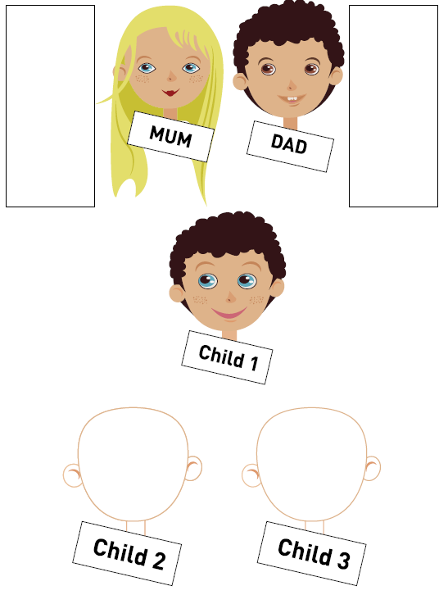
LQ: Do I understand that I am who I am because part of each of my parents made me?
What might each of the other children look like?
How did you make your decision?

Slide 31
Lesson 2

Slide 32
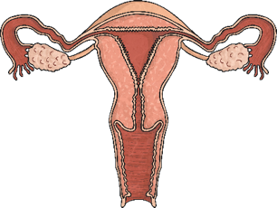

Human Reproduction
LQ: Do I know the names of the male and female reproductive organs and what’s needed to make a baby?
Do you know what any of these pictures show?
They are all vital in the process of Human Reproduction.

Slide 33
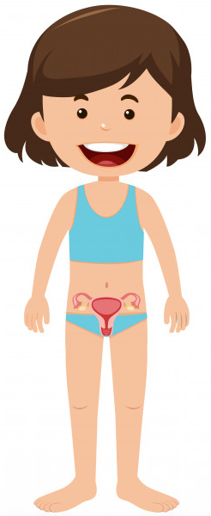
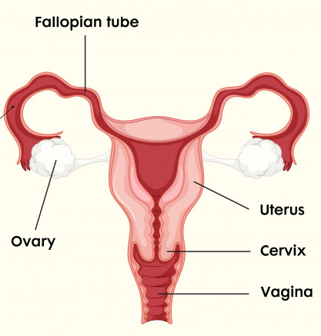
Female reproductive system
LQ: Do I know the names of the male and female reproductive organs and what’s needed to make a baby?
This is a magnified image of an egg. The eggs (ovum) are stored in the ovaries.

Slide 34
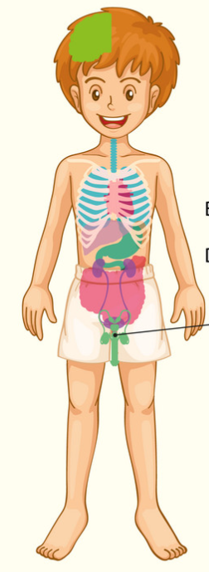
Male reproductive system
LQ: Do I know the names of the male and female reproductive organs and what’s needed to make a baby?
Bladder
Penis
This is a magnified image of a sperm. The sperm are stored in the testicles.
Rectum
Testicles

Slide 35
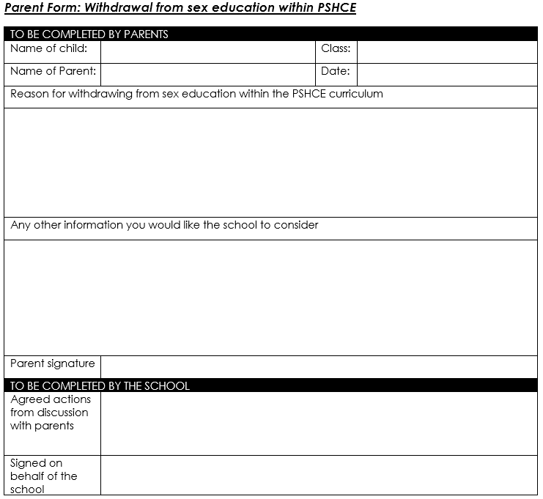
Right to withdraw:

